Slide 1
Qualified High Deductible Health Plan (QHDHP) with Health Savings Account (HSA)
Notes:
Muhlenberg College is pleased to announce the addition of a second medical plan offering for 2024. In addition to the PPO plan, Muhlenberg is also offering a Qualified High Deductible Health plan with Health Savings Account.
During today’s presentation, we will review the QHDHP with HSA plan design as well as the rules & regulations around health savings accounts (HSAs)

Slide 2
Qualified High Deductible Health Plan (QHDHP)
A QHDHP is a Health Savings Account (HSA)-compatible health plan with annual deductibles and out-of-pocket limits that comply with IRS requirements. The IRS adjusts the limits each year for inflation.
A QHDHP cannot pay benefits until the plan’s deductible is met for that plan year. An exception applies for preventive care services that can be paid with no deductible (based on the CBC preventive care schedule).
In a QHDHP ALL expenses are applied to the deductible (both medical & rx) until the deductible is met
You will pay the negotiated rate for the provider charge/prescription until the deductible is met.
For example: You go to your PCP because you are ill; the negotiated rate that CBC has with the PCP is $125 – you will pay the full $125 for that visit, and it will apply to your deductible (if your deductible has not been met). You go to the pharmacy to pickup an antibiotic for your illness; the charge for that antibiotic is $65 - you will pay the full $65 for the prescription, and it will apply to your deductible (if your deductible has not been met)
When the deductible is met, 20%-member coinsurance applies to all services (until the out-of-pocket maximum is met).

Slide 3
QHDHP Medical Highlights
*QHDHP – the deductible is combined to include medical and prescription drug providers for in-network providers.
**The out-of-pocket maximum includes the deductible all eligible copays and coinsurance amounts.
 | Capital Blue Cross QHDHP w/HSA (In-Network benefits illustrated)
Annual Deductible* | $3,500 per individual $7,000 per family
Annual Out-of-Pocket Maximum** | $8,050 per individual $16,100 per family
Plan Coinsurance (member) | 20% after deductible
Office Visit | 20% after deductible
Lab & X-ray | 20% after deductible
Complex Radiology | 20% after deductible
Inpatient Hospital | 20% after deductible
Emergency Room | 20% after deductible
Preventive Care (following the CBC preventive care schedule) is covered at 100% at In-Network providers, the deductible is waived.
Benefits illustrated are In-Network (member responsibility); see Capital Blue Cross Benefit Summary for additional details.
Notes:
The deductible on the Muhlenberg QHDHP is NOT aggregate!

Slide 4
QHDHP Rx Highlights
 | Prescription benefits are through Express Scripts, administered by RxBenefits
Rx Deductible | combined with medical deductible
Retail Prescription Drugs (31-day supply)
Generic | 20% after deductible
Preferred Brand Name | 20% after deductible
Non-Preferred Brand Name | 20% after deductible
Mail-Order Prescriptions (90-day supply)
Mandatory for Maintenance Rx? | One original fill plus two refills are covered at retail. Subsequent refills are covered through mail order only.
Generic | 20% after deductible
Preferred Brand Name | 20% after deductible
Non-Preferred Brand Name | 20% after deductible
Preferred Specialty (31-day supply) obtained through Accredo
Preferred Specialty | 20% after deductible
Notes:
Do you want payroll contributions for this plan included?

Slide 5
Health savings account (hSa)

Slide 6
Health Savings Account (HSA)
If you enroll in the Qualified High Deductible Health Plan (QHDHP) for 2024, you may be eligible to make/receive HSA contributions.
What is a Health Savings Account (HSA)?
A health savings account (HSA) is an account that you can use to pay medical expenses.
This account helps offset your medical costs by giving you tax advantages, allowing your income to stretch farther by using the dollars that would have otherwise been paid in taxes.
BUT there are still a few rules:
You have to be eligible to have a HSA
You have to spend the dollars on qualified medical expenses and keep itemized receipts.

Slide 7
Health Savings Account (HSA)
A Health Savings Account (HSA) provides a triple tax advantage
Contributions to the HSA are made pre-tax
The account earns interest tax-free
Distributions are tax free (as long as they are utilized for qualified expenses)
The account is owned by the employee
There is no “use or lose” rule like a FSA; unused funds remain in the account until they are utilized.
When the account reaches a certain dollar threshold, investment opportunities are available.
Muhlenberg has selected P&A Group as our HSA administrator (more information about P&A Group will be provided later in this presentation).

Slide 8
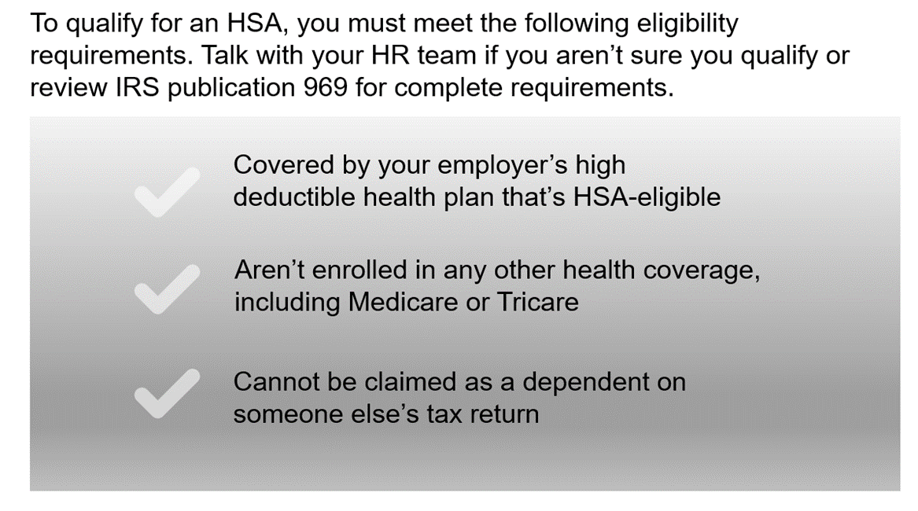
Health Savings Account (HSA)
You cannot be enrolled in a healthcare FSA or have rollover dollars available to open a HSA; if you are currently enrolled in the healthcare FSA and are considering the HSA for 2024, ensure that your FSA dollars are spent by 12/31/23. FSA dollars not spent by 12/31 will be transferred to a Limited Purpose FSA and can be used for dental & vision expenses only.

Slide 9
Special Rules for Married Individuals
If married individuals both have a QHDHP with HSA, and either spouse has family coverage, both spouses are treated as having only that family coverage
If both are HSA eligible, the HSA contribution limit is divided between spouses and cannot exceed the annual family limit
This rule applies even if one spouse has family coverage and the other has self-only coverage

Slide 10
Medicare Entitlement
Individuals entitled to Medicare are not eligible for HSA contributions;
Medicare entitlement means being both eligible and enrolled;
Individuals can contribute to their HSA as long as they are an eligible individual and have not enrolled in Medicare Part A, B or D;
If an Individual turns age 65, is still working and is not enrolled in Medicare, they are still eligible to contribute to an HSA.

Slide 11
HSA
How Much Can I Contribute?
Individual Enrollment:
$4,150
Family Enrollment:
$8,300
Remember:
These maximums include any employer contributions (annual maximums are set by the IRS).
Muhlenberg will contribute $750 for those enrolled in single coverage & $1,500 for those enrolled in non-single coverage (funding will be provided monthly)
Those 55 years and older and not enrolled in Medicare can contribute an additional $1,000 “catch-up” each year.

Slide 12
HSA: Who Can Spend the Dollars?
HSAs may reimburse any qualified health expense of the:
Account holder
(i.e. employee)
Account holder’s legal spouse
Any tax dependents
of the account holder
Non-Tax Dependents and Domestic Partners:
Expenses of non-tax dependents are not eligible for reimbursement through the account holders HSA, however if they are HSA-eligible, i.e. have no other disqualifying coverage, they can open their own HSA!

Slide 13
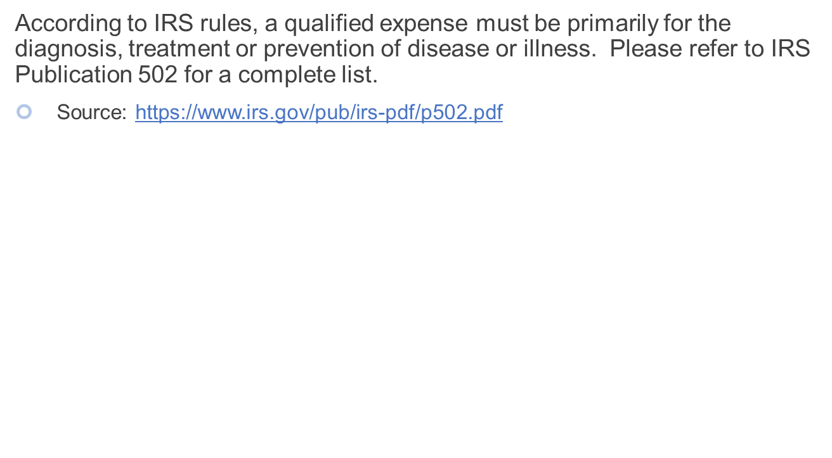
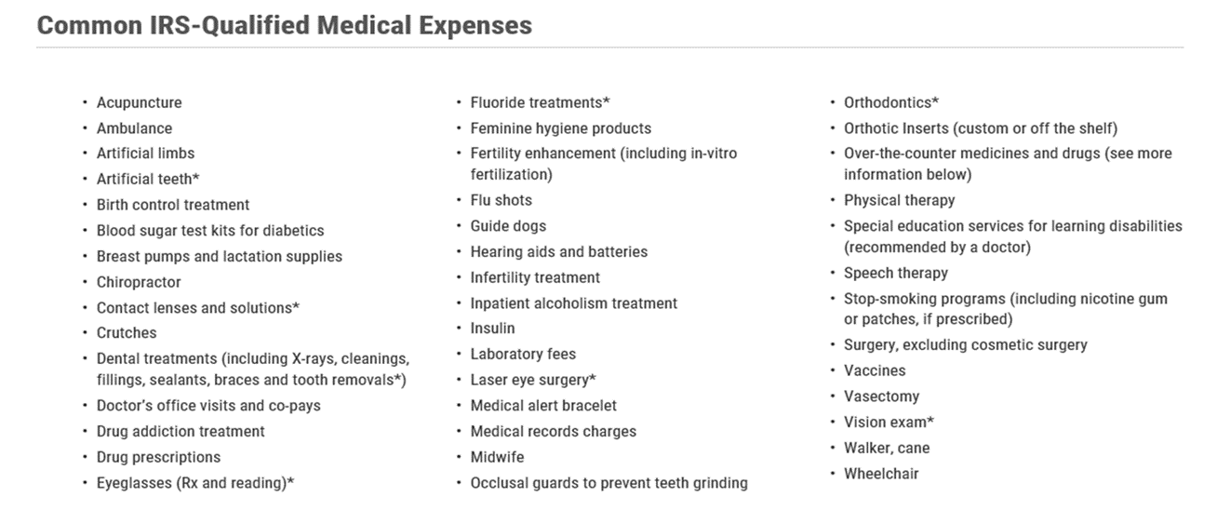
HSA – Examples of Qualified Expenses

Slide 14
HSA: Additional Eligible Expenses
Other eligible expenses for tax-free distributions include:
Premiums for COBRA
Premiums for coverage while receiving unemployment compensation under State Law
Premiums for individuals over age 65 (Medicare premiums)
Note: if you terminate employment or coverage under the QHDHP
You cannot use the funds in the HSA to cover premiums for coverage under another employers plan
You can use the funds for out-of-pocket expenses such as copays and deductibles.

Slide 15
HSA: Record Checklist
You must keep records sufficient to show that:
The distributions were exclusively to pay or reimburse qualified medical expenses
The qualified medical expenses had not been previously paid or reimbursed from another source
The medical expenses had not been taken as an itemized deduction in any year
Do not send these records with your tax return. Keep them with your tax records

Slide 16
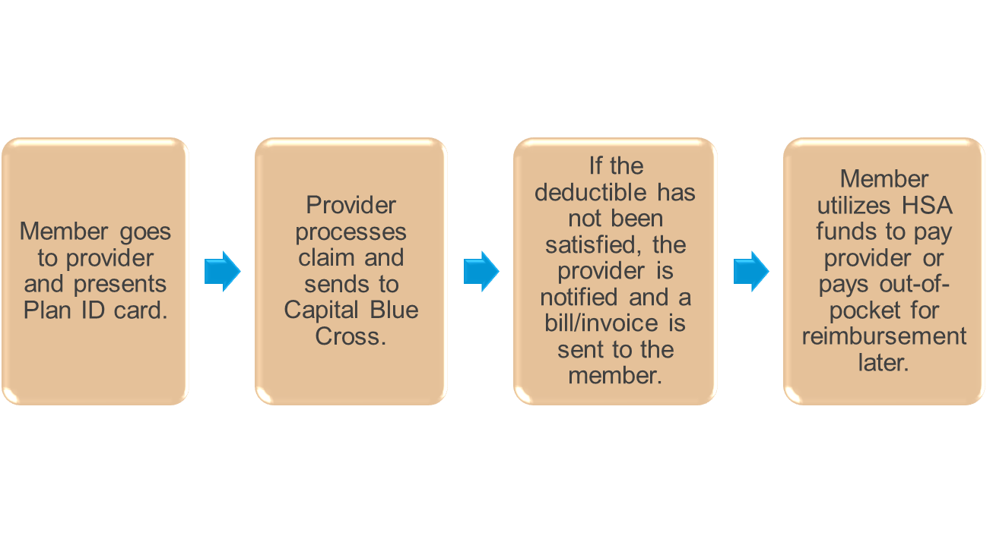
Using your HSA for a Provider Visit

Slide 17
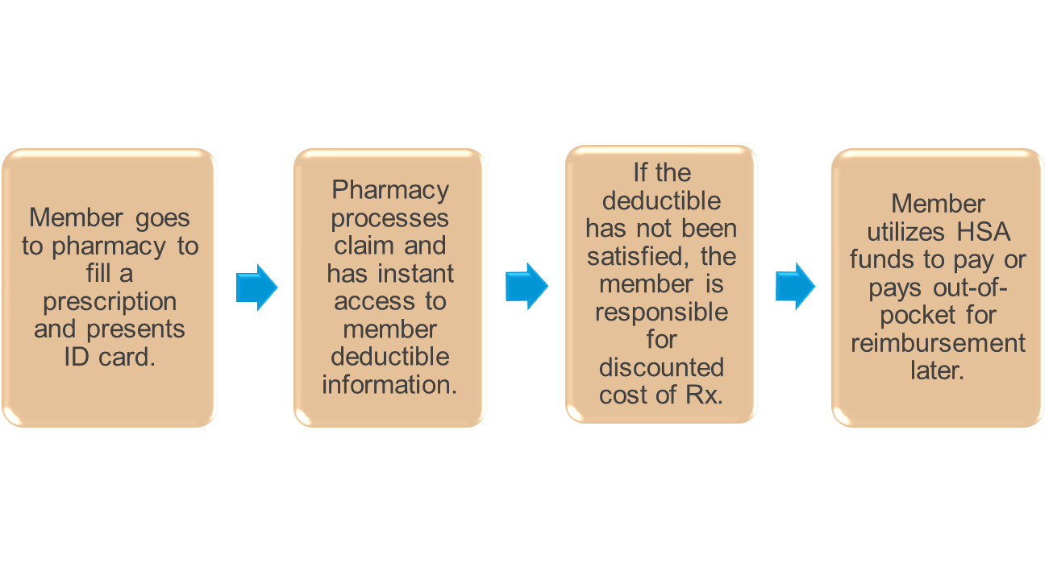
Using your HSA for Prescription Drugs

Slide 18
P&A Group
P&A Group is the Health Savings Account administrator
A Health Savings Account (HSA) is an individual banking account, once you apply for a HSA and before your account can be opened, P&A will need to confirm your full name, residential mailing address, birth date and social security number as required by the USA Patriot Act. This process is called the Customer Identification Program or CIP.
Muhlenberg College will submit your enrollment information to P&A Group. P&A Group will reach out to you directly if you did not pass the CIP and additional information is needed.
Be sure to respond promptly if P&A Group reaches out to you for additional information to open your HSA.

Slide 19
P&A Group
After your account has been opened, you will receive a HSA debit card from P&A Group. This card can be utilized to pay for qualifying expenses at the point of sale (be sure to keep your receipts as previously discussed).
You can order additional debit cards for your spouse and eligible dependents on the P&A website.
If you are not able to pay a provider utilizing the HSA debit card, you can pay the provider directly from your account via the P&A portal or you can reimburse yourself if you paid for the service out of pocket.

Slide 20
P&A Group
Tax reporting
IRS form 8889 must be completed with your tax return each year to report total deposits and withdrawals from your account. You do not have to itemize to complete this form.
Investment Accounts
Once your HSA balance reaches $1,000, you can transfer funds to an HSA investment account. Information is available on the P&A member portal about investment account options.
Beneficiaries
Be sure to access your account to designate beneficiaries

Slide 21
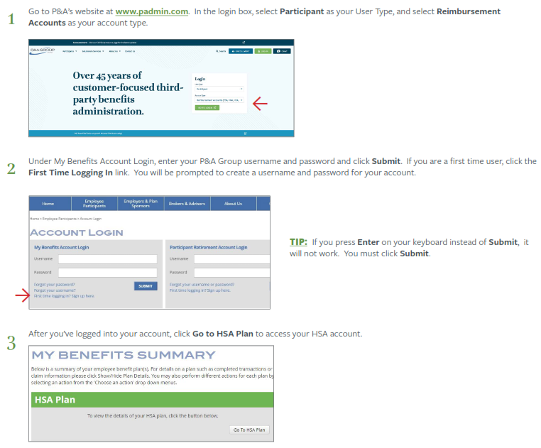
P&A Group Participant Support Center & Member Portal
Web: www.padmin.com
Phone: 716-852-2611
Hours: Monday – Friday 8:30 am – 10:00 pm EST

Slide 22
HSA: Which Is The Best Plan?
While we can not recommend a plan for you, some things to consider when selecting your medical plan for 2024:
 | QHDHP | PPO Plan
Would you rather pay more money as you incur services or pay more each pay period? | Least amount of money out of your paycheck – you will pay more when you incur services. | Most money out of your paycheck – set copays for many services.
Do you take expensive or several prescription drugs? | If yes, are you comfortable with paying 100% of the cost up to your deductible then the applicable co-pay up to the OOPM? | If yes, the deductible does not apply and there are set copays per prescription type.
Are you looking for a tax advantaged savings method? | If yes, this plan allows you to set aside money in an HSA that you can use for healthcare expenses or retirement. | If yes, this plan does not provide access to any special accounts like an HSA.
Are you covering a dependent on the medical coverage? | If yes, this plan has a separate deductible and OOPM per person, to a family maximum. | If yes, this plan has a separate deductible and OOPM per person, to a family maximum.
Which plan is better? | Both are quality plans. It just depends on your financial point of view, medical needs and long term financial goals and objectives. Both plans provide comprehensive coverage and include an out-of-pocket maximum (though the amount varies based on plan selection).

